Slide 1


Motivation for thinking about probability.
Your intuition can let you down seriously!
What is weighed in the scales of justice?
This is not the usual
statistical approach

Slide 2
Case 1
You obtain a partial DNA profile from an crime scene. The match. The local police officer suggests a suspect, and you find a match.
Case 2
Is the same, except the local police officer could not suggest a suspect. The police search a database of a million criminals and find one match.
In which case is the evidence stronger?
How much stronger?

Slide 3
What if the database had been 40 million people in a country of 60 million
What if everyone was on the database?
Our initial intuition may have failed us: to progress we need some basic rules of probability

Slide 4
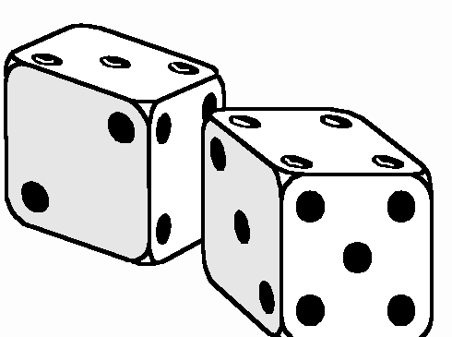
One die: what is the chance of throwing a 3?
Two dice: what is the chance of throwing 3 on each

Slide 5
One die: what is the chance of throwing a 3 or 6
Lesson: when there several (exclusive) ways of getting an outcome we must add them

Slide 6
Two dice: what is the chance of throwing at least one 6?

Slide 7
1 2 3 4 5 6
1
2
3
4
5
6
Lesson: if events are not exclusive, the chance of joint events must be considered

Slide 8
P(A & B) = P(A)P(B)
P(A or B)=P(A)+P(B)-P(A&B)

Slide 9
Conditional probabilities
Suppose 90% of professional basketball players are taller than 1.8 metres
Whereas only 10% of spectators are.
A stadium contains 990 spectators and 10 professional basketball players
If you see someone leaving after the match over 1.8M tall, what is the chance he is one of the basketball players? (have a guess now)

Slide 10
990 x 0.1=99
is the expected number of people in the audience over 1.8M
10 x 0.9 =9
is the expected number of players over 1.8M
I.e. the probability of it being a player is 9:99 or 1:11 or 1/12
So it is 11 times more likely to be a member of the public.
Lesson: odds are not quite the same as probabilities
Lesson: you need to take into account not only the evidence (over 1.8M), but also the prior probability of the two theories (player or public)

Slide 11
P(Data | H1) is the likelihood
P(H1) is the prior probability
P(H1 | Data) is the posterior probability
In odds form -
Prior(H1) x Likelihood(H1) : Sum _{i≠1} Prior(Hi)xLikelihood(Hi)

Slide 12
You reinvented Bayes theorum!
Lets use B - for the hypothesis he’s a basketball player
S- for the hypothesis he’s spectator
Posterior odds:
P(Evidence|B) P(B) : P(Evidence |S) P(s)
In probabilty form:
P(B|Evidence) = P(Evidence|B)P(B)
P(Evidence|B)P(B)+P(Evidence|S)P(S)

Slide 13
10 Players
990 Spectators
H_{i} is the hypothesis person i did it
For each player
P(H_{i}) = 1/1000
P(Evidence | H_{i} ) = 0.9
For each spectator
P(H_{i}) = 1/1000
P(Evidence | H_{i} ) = 0.1
Odds = .009 : .099
(or 1 : 11)
Total weight of evidence
10 x1/1000 x 0.9 = 0.009
Total weight of evidence
99- x 1/1000 x 0.1 = .099

Slide 14
Case 1
You obtain a partial DNA profile from an crime scene. The match probability is 1 in a million. The local police officer suggests a suspect, and you find a match.
Case 2
Is the same, except the local police officer could not suggest a suspect. The police search a database of a million criminals and find one match.
In which case is the evidence stronger?
How much stronger?

Slide 15
Back to the original motivation:
In the first case the prior on the suspect was high
In the second it was close to 1/60 million
But the weight of the genetic evidence is the same in each case.
Priors: are for the jury (not prior in the sense of before)
Evidence: is for the expert to evaluate
Problem: how do we get this across in court?
The jury must combine them.

Slide 16
In a city of 1 million people, a crime is committed. The criminal leaves behind a hair type occuring in 1/1000 of the population. The suspect has that type of hair.
So called prosecutor’s fallacy (transposed conditional):
The chance of innocence is 1 in 1000, so the chance of guilt is 999 in 1000
So called defender’s fallacy
There are 1000 people who match in the city, the defendant is only one of them so the chance of guilt is 1 in 1000
They could either be right with an appropriate prior!
(1/1,000,00 or ½)

Slide 17
P(Data | H1) is the likelihood
P(H1) is the prior
P(H1 | Data) is the posterior probability
In odds form -
Prior(Accused) x Likelihood(Accused) : Prior(Alternative1)xLikelihood(Alternative 1)
+ Prior(Alternative2)xLikelihood(Alternative 2)
+ Prior(Alternative3)xLikelihood(Alternative 3)
… etc.

Slide 18
Database
Prior 0.99/7M
Likelihood 1/1M
No. 1M
Peter
Prior 0.01
Likelihood 1
No. 1
Rest of UK
Prior 0.99/7M
Likelihood 1/1M
No. 6M
Not Guilty 0.99 x 10⁻⁶
Guilty 10⁻²
10101: 1

Slide 19
Random Joe
Prior 1/7M
Likelihood 1
No. 1
Database
Prior 1/7M
Likelihood 0
No. 1M-1
Guilty 1/7M
Rest of UK
Prior 1/7M
Likelihood 1/1M
No. 6M
Not Guilty 6/7M
1 : 6

Slide 20
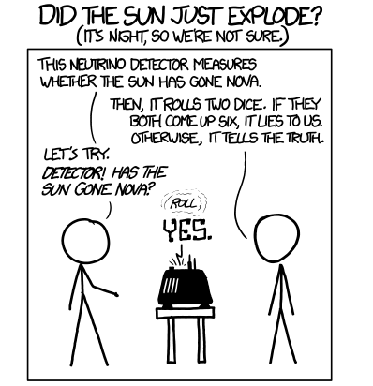
Frequentists vs Bayesians (xkcd)

Slide 21
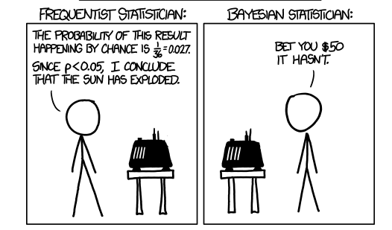

Slide 22
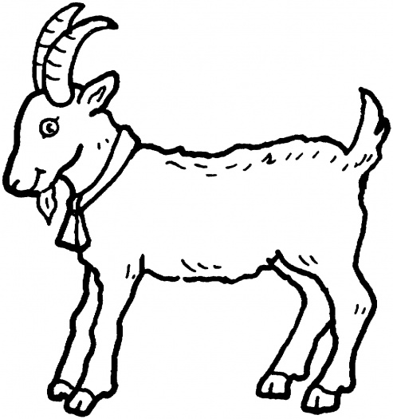

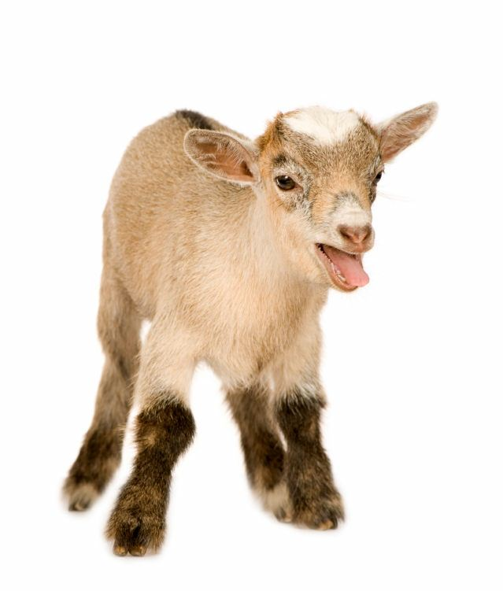
Two goats
One car
Three Doors
The Monty Hall Problem
He offers the chance switch to the other unopened door
Do you accept?

Slide 23
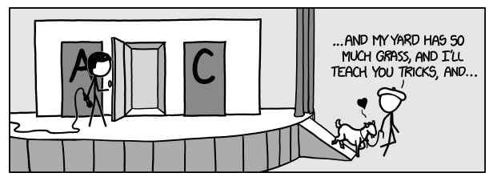

Slide 24
Homework:
What is the prior on H1 (car is behind your 1st choice)
H2 (car is behind the middle door)
H3 (car is behind the other door)
What are the likelihoods
… probability of the evidence
– that he reveals a goat behind mid door
given H1, H2 and H3
What are the posterior odds?
Does anything change if you believe that the host does not know where the car is and just opens a door at random?
What if you are unsure if the host knows?

Slide 25
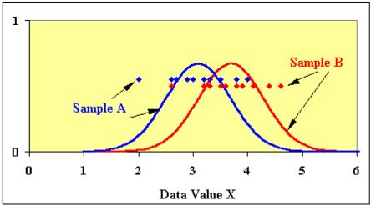
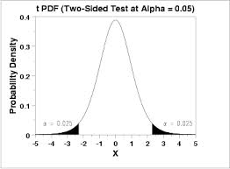

Example of the use of P-values
Data
are boiled down to a statistic
Which has an associated p-value

Slide 26
P-values
True or False
It is the probability that the null hypothesis is true
It is the probability that the alternative hypothesis is false
It is the probability of the observed value of the statistic
It assumes the null hypothesis is true
A small P-value shows there is a large difference between means

Slide 27

Three trees, four apples sampled each
Tree 3
Tree 1
Tree 2

Slide 28
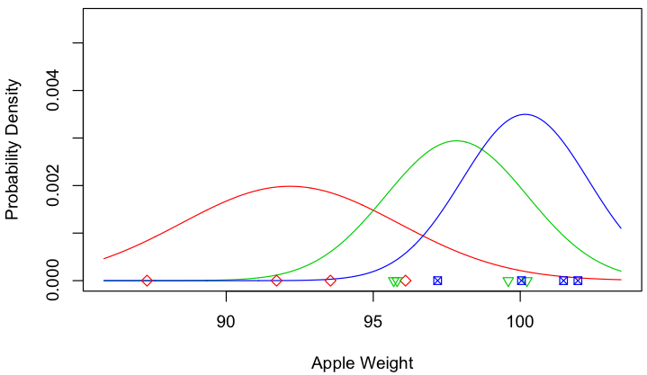

Slide 29
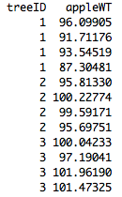
> Model1<- lm(appleWT~treeID)
>summary(Model1)
Coefficients:
Estimate Std. Error t value Pr(>|t|)
(Intercept) 92.165 1.419 64.955 2.45e-13 ***
treeID2 5.667 2.007 2.824 0.01991 *
treeID3 8.002 2.007 3.988 0.00317 **
> abline(v=92.165,col='red')
> abline(v=92.165+5.667,col='green')
> abline(v=92.165+8.002,col='blue')

Slide 30
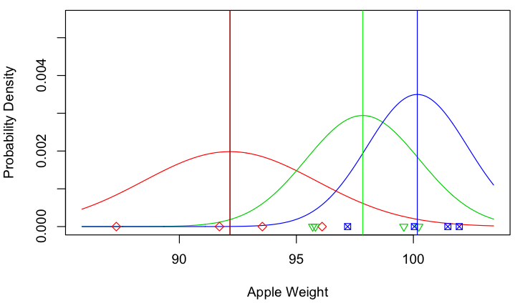

Slide 31
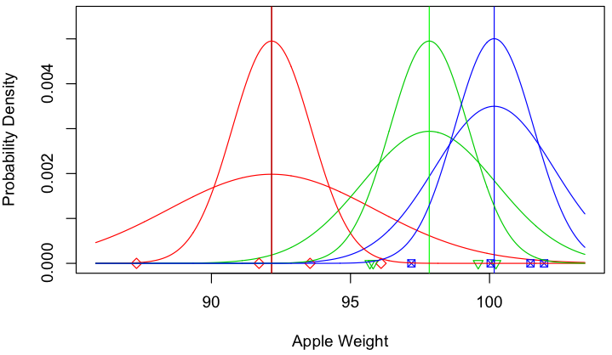
Actually our estimate of the mean is best represented
by a curve

Slide 32
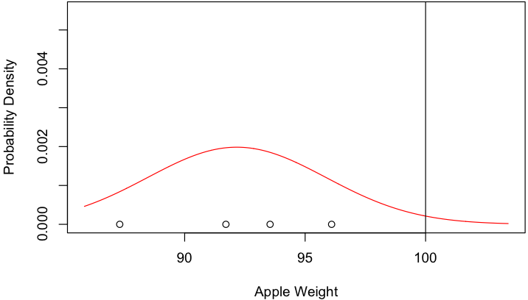

Slide 33
Posterior odds = P(hypothesis) P(Data | hypothesis)
Hypothesis: mean = 100
What is
P(Data | mean=100)

Slide 34
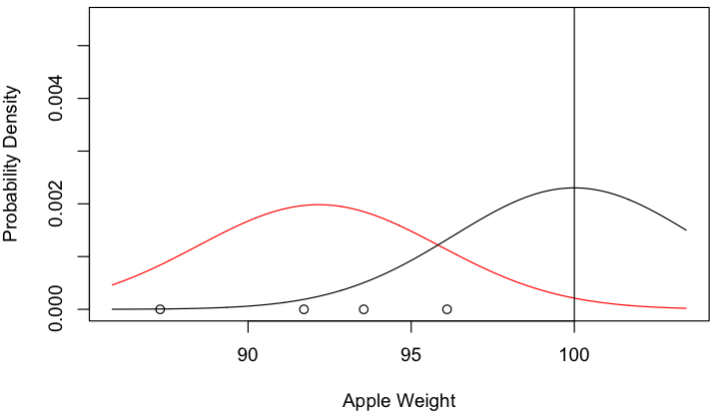

Slide 35
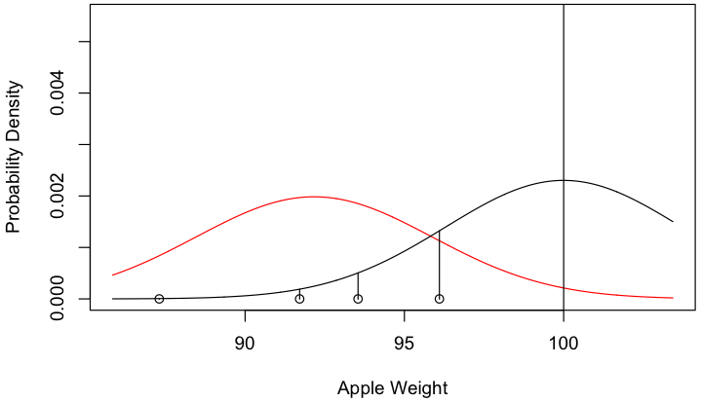

Slide 36
Posterior odds = P(hypothesis) P(Data | hypothesis)
Hypothesis: mean = 100
What is
P(Data | mean=100) = h1 x h2 x h3 x h4

Slide 38
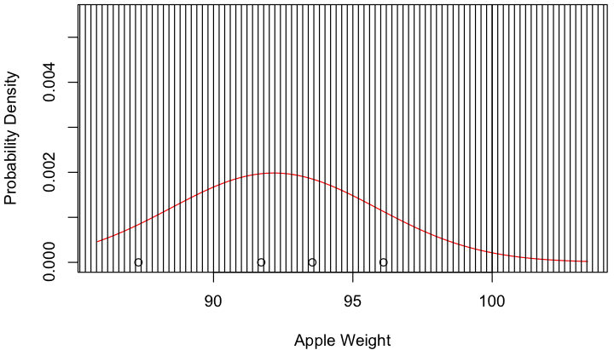

Slide 39
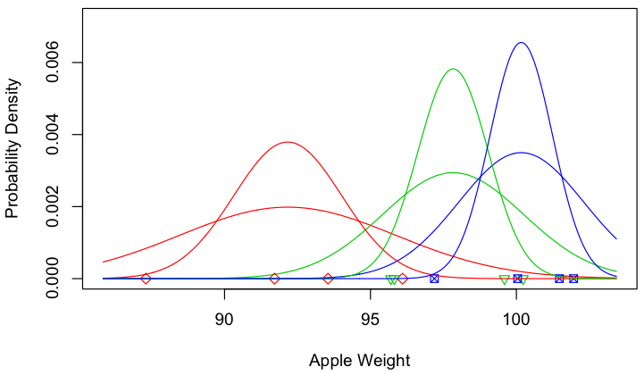
Remember the difference between normal curve for apple weights and posterior curve estimating the mean

Slide 40
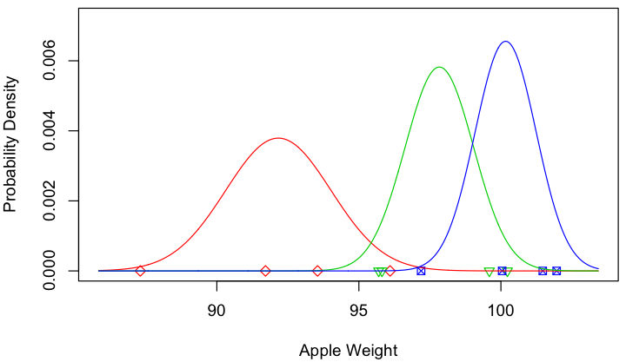

Slide 41
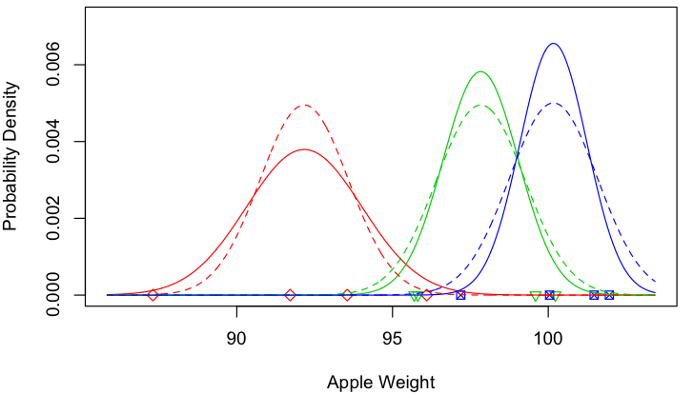
Sharing information:
assume all trees have same variance in apple weights

Slide 42
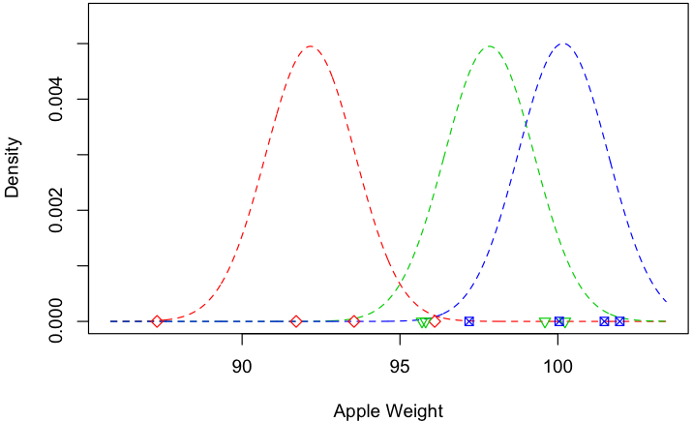

Slide 43
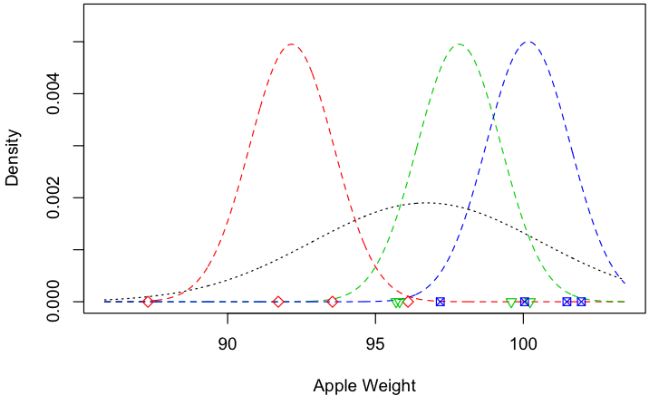

Slide 44
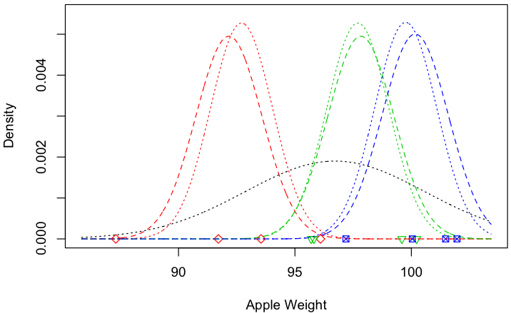

Slide 45
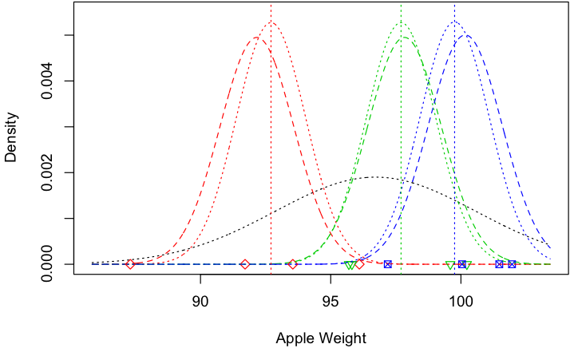

Slide 46
Sharing information between trees 2
(remember we already assumed they had the same variance in weight around their means)
Now assume the trees have average weights drawn from the same normal distribution.
We now have two different likelihoods
P(a tree mean | distribution of tree means)
P(data | given the tree mean)

Slide 48
Note: we only have to estimate
one mean and
one variance (for the trees)
another variance (for the apples on a tree)
not 3 means and 3 variances
Note: the ‘shrinkage of the estimates towards the mean.
Examples of the logic
Sophomore-slump in sport
Accident blackspot crash rates

Slide 49
Good but
unlucky
Freshman year
Sophomore year
Good lucky performer

Slide 50
Model1<-lm(appleWT~treeID)
Model2<-lme(appleWT~1,random= ~1|treeID)
Model1
Coefficients:
(Intercept) treeID2 treeID3
92.165 5.667 8.002
Model2
(Intercept)
96.72158
Random effects:
Formula: ~1 | treeID
(Intercept) Residual
StdDev: 3.862575 2.837830

Slide 51

Exercise
Fertilizer Year1 Year 2 …. Year 10
Unknown Year1 Year 2 …. Year 10
Year 1 Year 2 … Year 10

Slide 52
Analogy for GLUP methods
Take two apples from each row:
2 from left
2 from right or one of each
Weigh the total
Remember what you took
Do it again and again in different
Years. Record fertilizer, weather etc too

Slide 53
27.1
22.3
19.7
25.5
1 0 1
0 -1 1
-1 1 0
0 1 -1
3.1
-2.3
1.7
23.1
23.1
23.1
23.1
e1
e2
e3
e4
=
x
+
+
Fit distribution
(infer values)
Fit mean
Fit distribution
Known trait values
Known genotypes

